Slide 1
Proposed MOA / MOU on Ota Well Water Credits, North Kona, Hawai`i Island
Item G-2
Hawaiian Homes Commission (HHC) Meeting (online)
Jonathan Likeke Scheuer, Consultant
September 21, 2020

Slide 2
West Hawai‘i Water Projects & Issues
  HHC Water Policy Plan Related Goals
  Keauhou and Other Water Reservations
  Designation / Review of Permits
  Comment Letter & Methodology
  Proposed MOA / MOU
Notes:
Mention the WPP

Slide 3
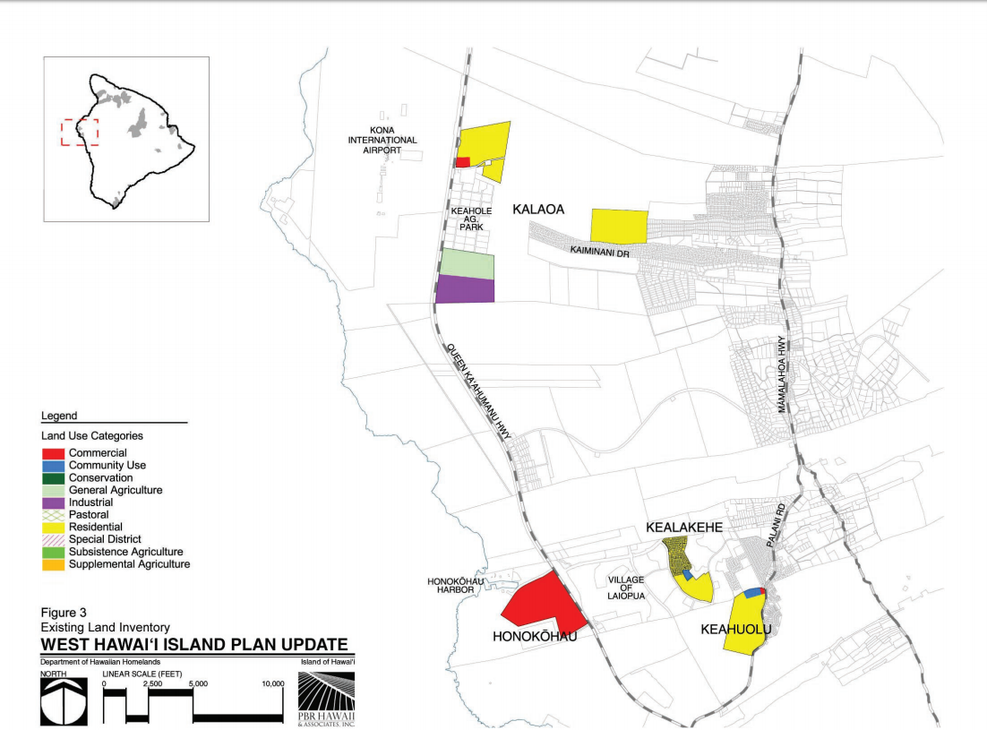
Kealakehe
Planning
Region

Slide 4
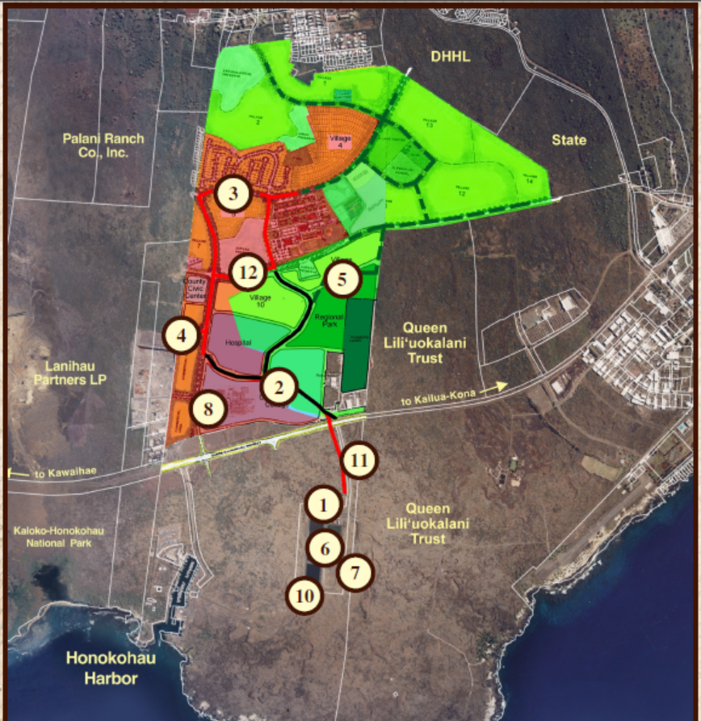
Kealakehe

Slide 5
I. Relevant HHC WPP Goals
Goal 2. Aggressively, proactively, consistently and comprehensively advocate for the kuleana of the beneficiaries, the DHHL, and the HHC to water before all relevant agencies and entities.
Goal 6. Secure adequate and enforceable reservations of water for current and foreseeable future needs for all of its lands across the islands.
Notes:
WPP Passed June 14, 2014

Slide 6
II. Keauhou and Other Water Reservations
DHHL water “reservations”
  In water management areas (WMAs): HRS 174C-49(d)
  In all areas: HRS 174C-101(a)
  In conjunction with water leases: HRS 171-58(g)
  Once reserved, CWRM is not supposed to that allocate water to others
But, what does a reservation mean?

Slide 7
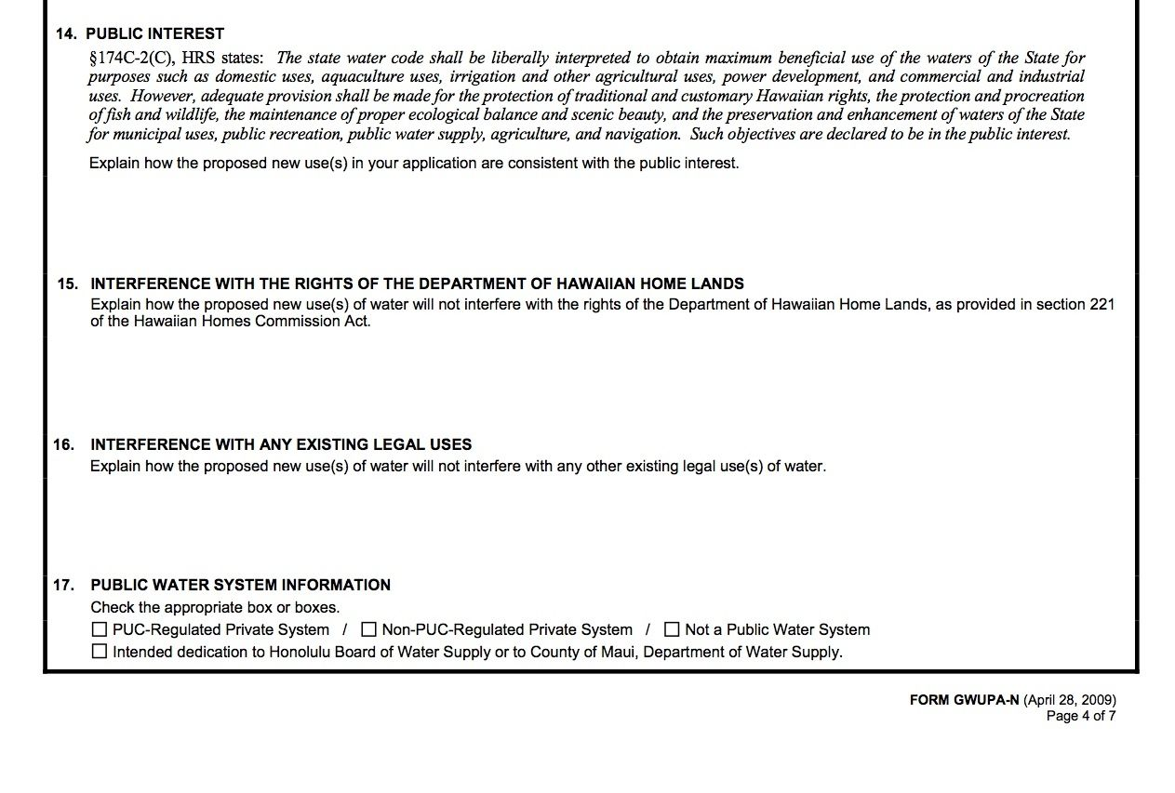
II. Reservations in WMAs
174C-49(e) All permits issued by the commission shall be subject to the rights of the department of Hawaiian home lands as provided in section 221 of the Hawaiian Homes Commission Act, whether or not the condition is explicitly stated in the permit.

Slide 8
II. Keauhou & Other non-WMA Reservations
Known:
  Counted toward allocation of Sustainable Yield
Possible:
  Condition on other permits
  Condition for County credits
  Conditions on 171-58 leases

Slide 9
III. Designation / Review of Permits
September 13, 2013 NPS petitions for Designation of Keauhou Aquifer
August 17, 2015 CWRM grants DHHL its first “101” reservation for Keauhou 3.398 mgd
February 14, 2017 CWRM rejects Designation with conditions
  Refer all well permits to Aha Moku and DHHL, with special conditions and /or referral to CWRM if needed

Slide 10
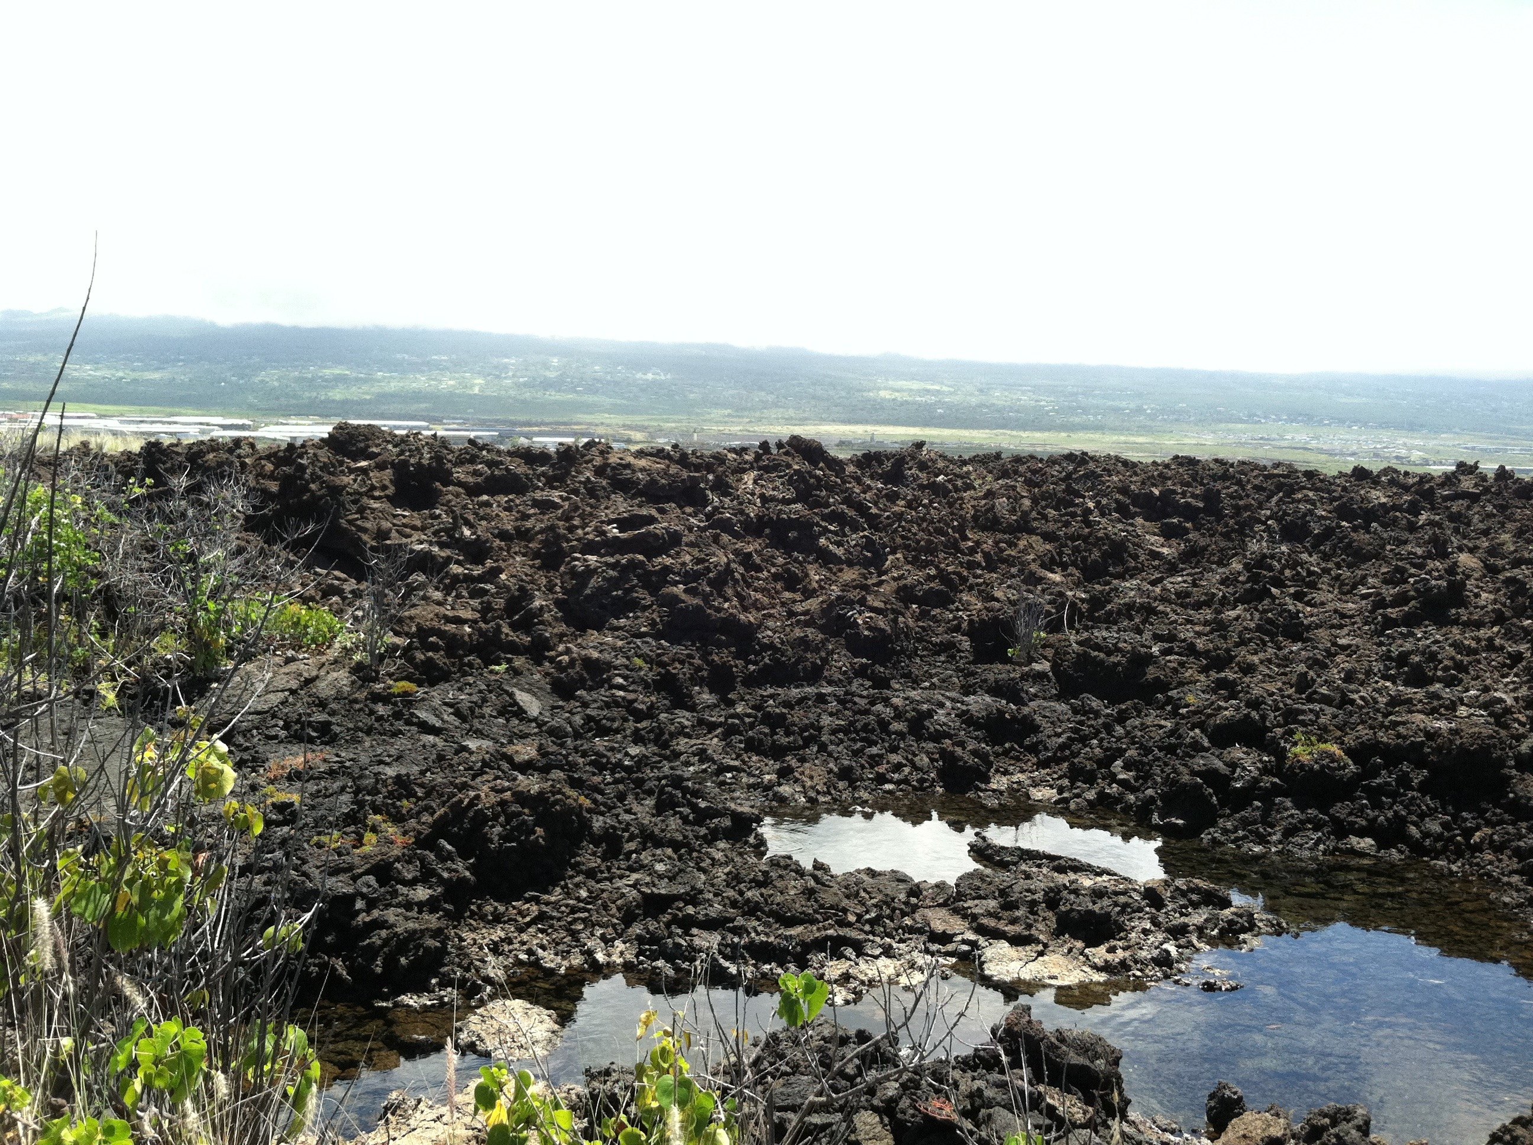
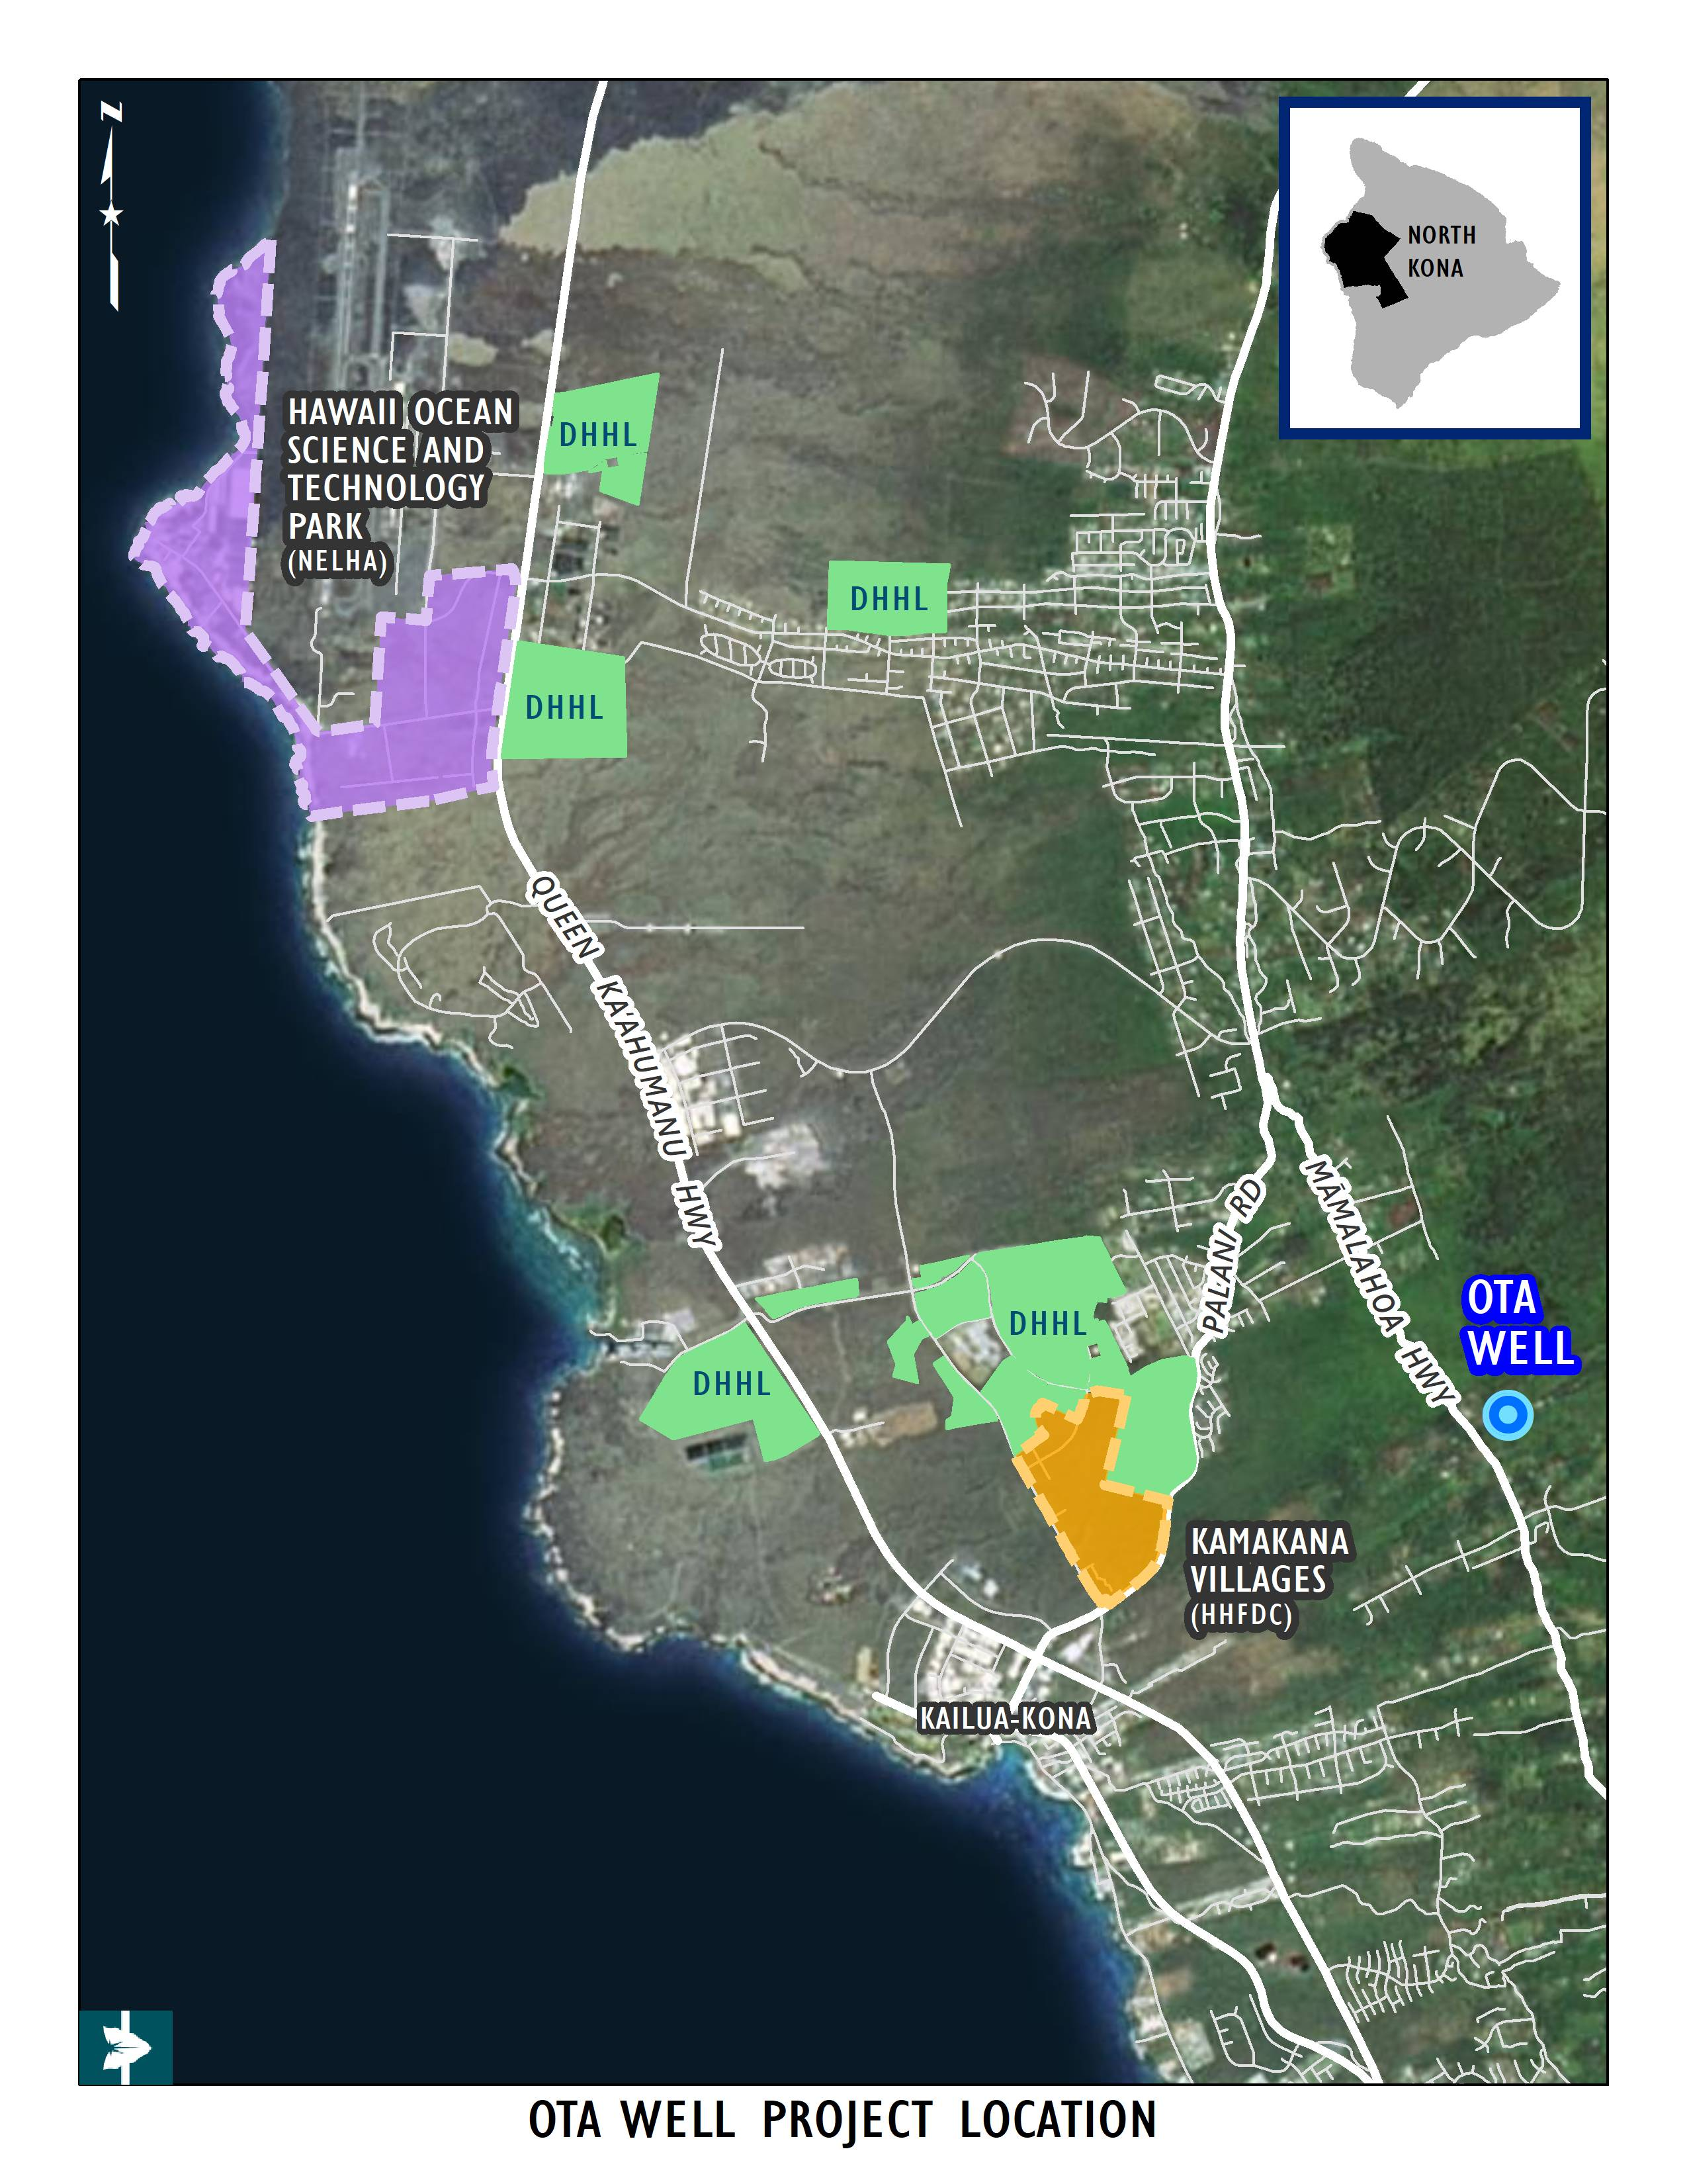
  IV. Ota Comment Letter & Methodology
HHFDC and NELHA pursued Ota well development
Primarily for commercial uses
EA FONSI 11/23/18
WC/PIP accepted on 10/18/18
Water Tank, Kailapa, Kawaihae

Slide 11
  IV. Ota Comment Letter & Methodology
December 20, 2018 DHHL comment letter
Sought condition or referral:
  Applicant sought 0.672 mgd
  Represents 2.69% of unallocated portion of the 38 mgd sustainable yield (25 mgd)
  Sought condition for equal percentage of the proposed yield to DHHL in the form of County water credits,
  18,077 gallons per day

Slide 12
  V. Proposed MOA / MOU
  NELHA & HHFDC agree w proposed conditions
  Memorialized in MOA / MOU
  18,077 gallons per day (approx. 30 credits)

Slide 13
Next steps?
  NPS proposed conditions as well
  CWRM expected to refer permit to full CWRM

